Slide 1
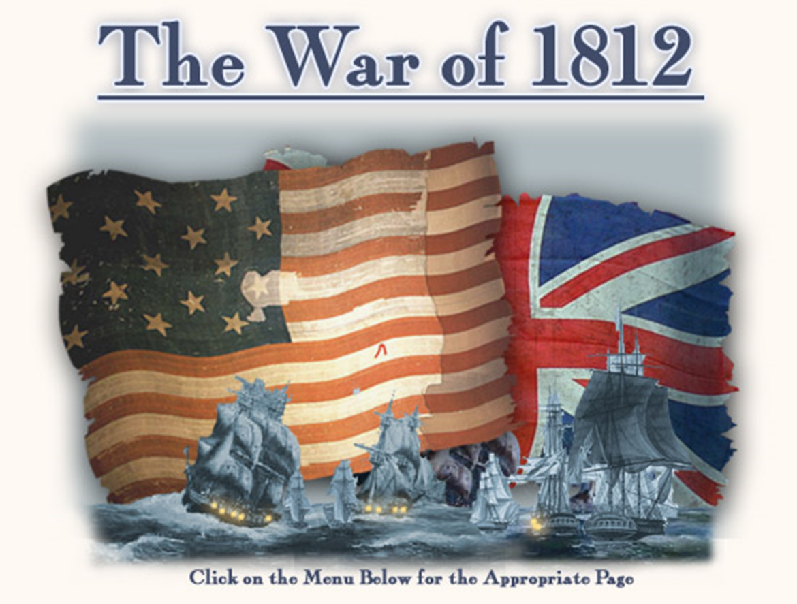
Mr. Condry’s Social Studies Class

Slide 2
Impressment
Britain and France at war
Impressment
Taking our sailors
Chesapeake Affair June 1807
HMS Leopard vs. USS Chesapeake
British took U.S. Sailors

Slide 3
Embargo Act- 1807
Embargo: Ban on trade
Jefferson’s attempts to stop Impressment
Stopped trade with all foreign countries
Hurt New England Stats
Could not make money
Plan failed

Slide 4
Non-Intercourse Act
Replaced the Embargo Act in 1809
Banned trade with France and England only
Did not Stop Impressment or help money problems.

Slide 5
Problems with the Native Americans
Tecumseh
Unites Native Americans in Indiana
Strong enough to stop U.S. settlers
Armed by British in Canada
Northwest Territories
Settlers flood into new territories
Native Americans try to unite

Slide 6
Call to War
Western War Hawks- men who wanted war against England and eyed Canada as a possible target of expansion
Famous Western War Hawk
Henry Clay
Kentucky
Southern War Hawks- men who had their eyes on Texas and Florida.
Famous Southern War Hawk
John C. Calhoun
South Carolina

Slide 7
Control of Canada
Hawks do not want Britain on North American Continent
Hawks want control of Canada
War Hawks want more land to settle

Slide 8
Madison Calls for War
June 18, 1812
Reasons:
Impressment
British helped Natives
Canada

Slide 9
United States vs. Britain
U.S. Forces
British Forces
Unprepared
Mainly Militia
Untrained Officers
Little Experience
Small Navy
World Power
Trained Soldiers
Trained Officers
A lot of Experience
Largest Navy in the World

Slide 10
Battle of Lake Erie
U.S. vs. British Ships- 1813
Battle to gain control over Lake Erie
Commodore Oliver Perry
Opened the door to Canada

Slide 11
Battle of Lake Eire
Fought September 10, 1813
United States Navy defeated and captured six vessels of British Royal Navy.
This allows for the Americans to recover Detroit and win the Battle of Thames to break the Indian confederation of Tecumseh.
One of the biggest naval battles of the war

Slide 12
Creek War
Southern Front: (1813-1814)
Florida
General Andrew Jackson
Destroys Creek Nation of Tallapoosa
America takes over Creek Land

Slide 13
British Attack
British Blockade U.S. ports
Start in Northeast and move to entire East Coast
Stopped U.S. Economy

Slide 14
Burning of Washington
Britain attacks Washington
Revenge for the destruction of Port Dover in Upper Canada
Defenses of Washington do not hold
Britain burns many important buildings
Only time in U.S. history that foreign invaders occupy Washington, D.C.
No American soldiers died as they retreated to safety from a 4,300 strong British force.

Slide 15
Buildings the British Burn in Washington
U.S. Capital
White House
United States Treasury
United States Department of War
Washington Naval Yard
The only thing that saved Washington D.C. from more damage was a huge thunderstorm possibly a hurricane that put out the fires.

Slide 16
Saving Washington
Dolley Madison
Saves the portrait of George Washington
Keeps American hopes alive
Symbol of American resolve

Slide 17
Battle of Baltimore
Fort McHenry
U.S. withstands British bombs for 25 hours
U.S. shows resolve to fight off British
If this for falls so does the nation.

Slide 18
Star Spangled Banner
Written during the bombing of Fort McHenry
Written by Francis Scott Key
Originally a poem
Shortened to make U.S. National Anthem in 1931

Slide 19
Treaty of Ghent
Peace treaty signed on December 24, 1814 in Belgium
All captured lands given back
U.S. seen as a power

Slide 20
Battle of New Orleans
Andrew Jackson leads the defense
Fights off British Attacks
Had smaller amounts of troops
Pirates
Cajuns
Free Slaves
Fought after peace treaty was signed

